Slide 1
Integrated Alarm System for the ALMA Observatory
EU funded ALMA development project
Erich Schmid
ESO ALMA Support Centre - ALMA Computing

Slide 2
Overview
Motivation – why do we need this?
Approach – doing things the right way
Status update – what has happened so far?
Next steps – how do we bring this into production?

Slide 3
Motivation
ALMA is much more than 66 antennas, a correlator and a database
Every component is important and must be monitored centrally 24/7
Consistent representation of alarms to avoid misjudgements
Increase system stability and hence operational efficiency
Notes:
Power generation and distribution, networking equipment, HVACs, etc.
At the moment alarms are inconsistent
Main motivation is efficiency

Slide 4
Things to be monitored (not complete)

Slide 5
What we have today
The ACS alarm panel (red circle) is the only official source of alarm notifications to the array operators
Only tabular representation, no situational awareness
Can by design never cover everything
Only available when the online software is running
Many prototype tools to cover the gaps – no consistency
Many “blind spots”
A good (bad) chance to miss out on important alarms or react too late
Notes:
Designed to be the ALMA SW alarm system only
Now showing several examples

Slide 6
ACS Alarm Panel

Slide 7
OMC

Slide 8
Critical Antenna Devices by AOG

Slide 9
Device Map by OMC+HCI

Slide 10
AOG Alarm Panel

Slide 11
Email Alarm Notification

Slide 12
Approach
Small internal study to determine requirements
Funds from ESO to cover travel and contracts
Collaboration of all ALMA partners
Contracts with experts
Started in October 2015, completed in June 2016

Slide 13
Status update
Identify all the relevant hardware and software systems. ✔
Document the existing alarm systems and available interfaces to access relevant data. ✔
Engage an external alarm system expert (ESA) ✔
Engage a human-computer interface expert (INRIA) ✔
Compile a report to stipulate the requirements for an integrated alarm system. ✔
Write a proposal for the upcoming call for ALMA development projects to design, implement and deploy an integrated alarm system. ✔

Slide 14
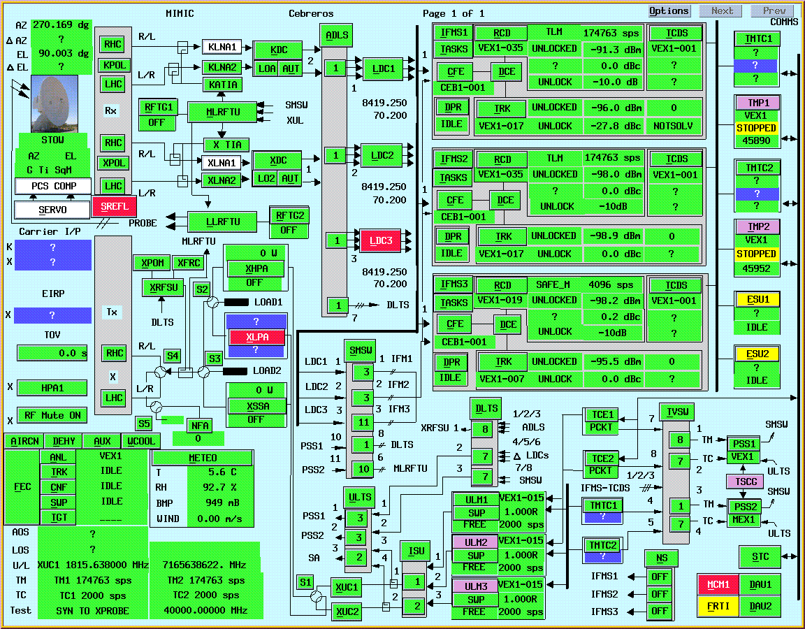
Overview of ESA model
Intuitive overview of the monitored information
Notes:
Alarm is to abnormal condition what a notification is to

Slide 15
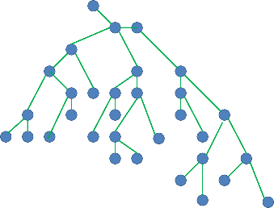
Overview of ESA model
Hierarchical model with alarm propagation
Notes:
Alarm is to abnormal condition what a notification is to

Slide 16
Overview of ESA model
Hierarchical model with alarm propagation
Notes:
Alarm is to abnormal condition what a notification is to

Slide 17
Overview of ESA model
Hierarchical model with alarm propagation
Notes:
Alarm is to abnormal condition what a notification is to

Slide 18
Overview of ESA model
Qualified values
Property X
Value
Validity
Alarm
Notes:
Alarm is to abnormal condition what a notification is to

Slide 19
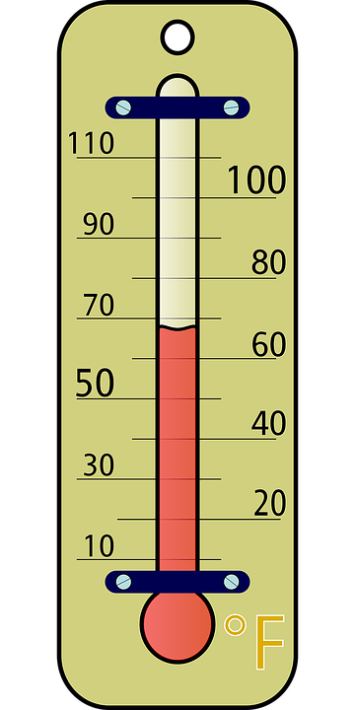
Overview of ESA model
Heterogeneous source – Homogeneous representation!
Property X
Value
Validity
Alarm
Notes:
Alarm is to abnormal condition what a notification is to

Slide 20
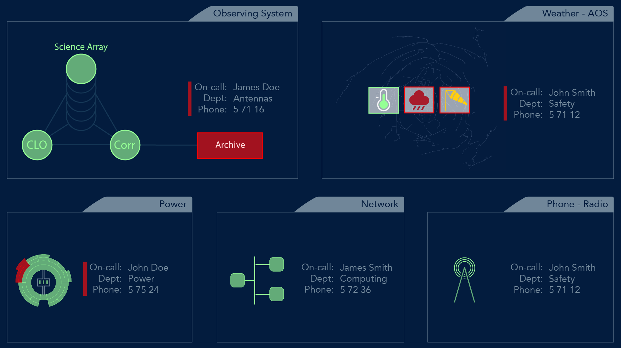
Alarm panel mock-ups
Observatory Overview Panel
Notes:
Will never be covered by other windows, dialogs

Slide 21
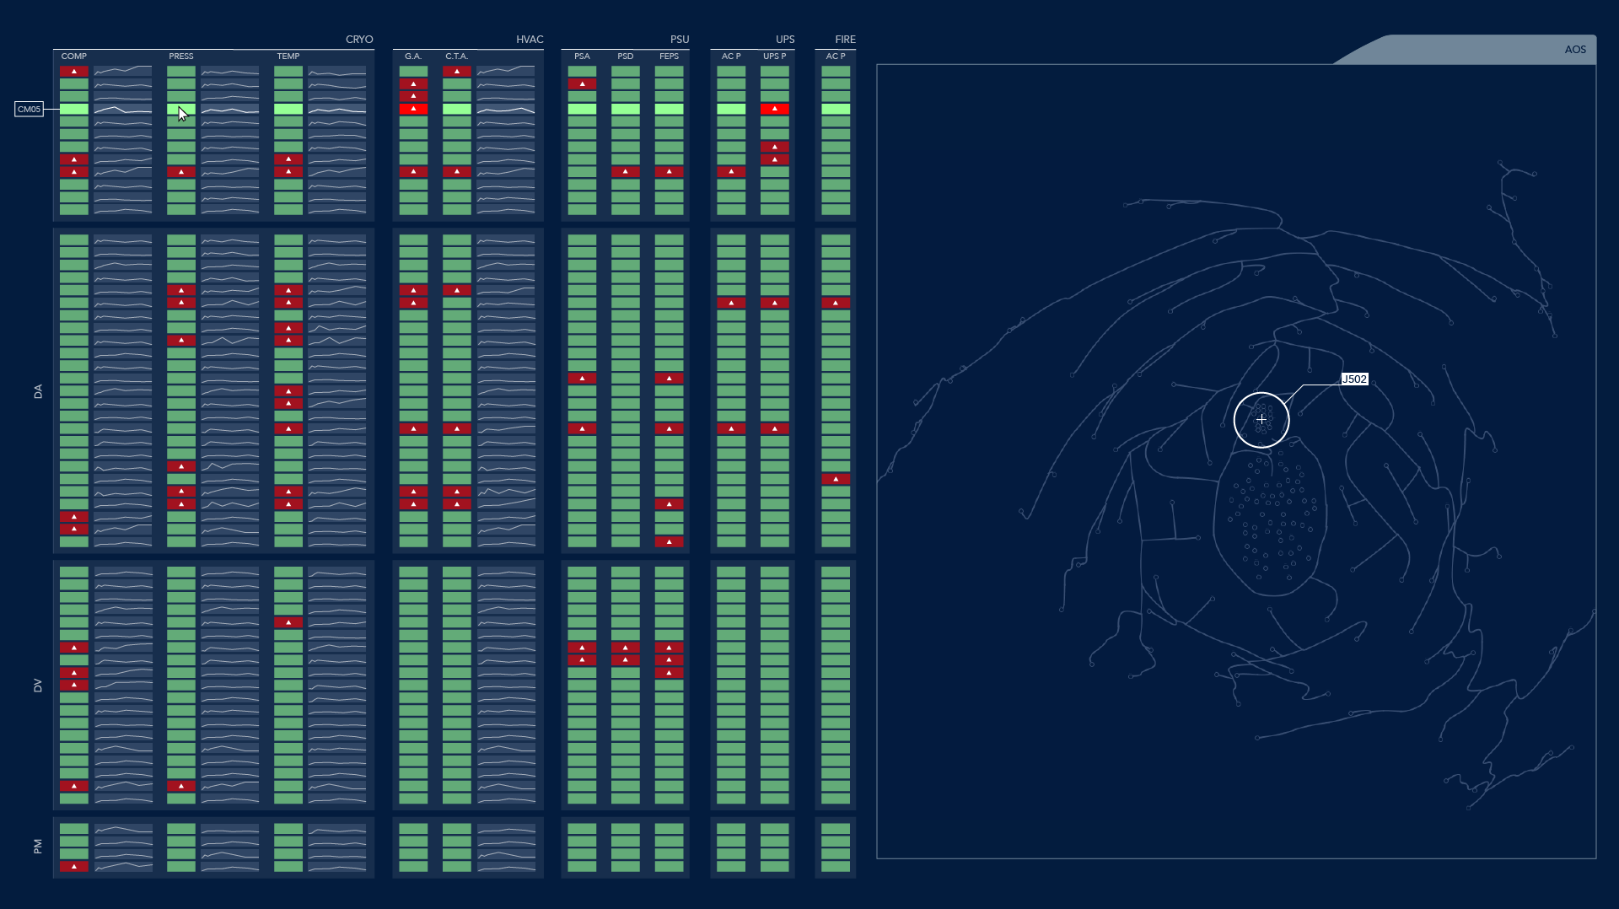
Alarm panel mock-ups
Array elements

Slide 22
Alarm panel mock-ups
Visualization techniques

Slide 23
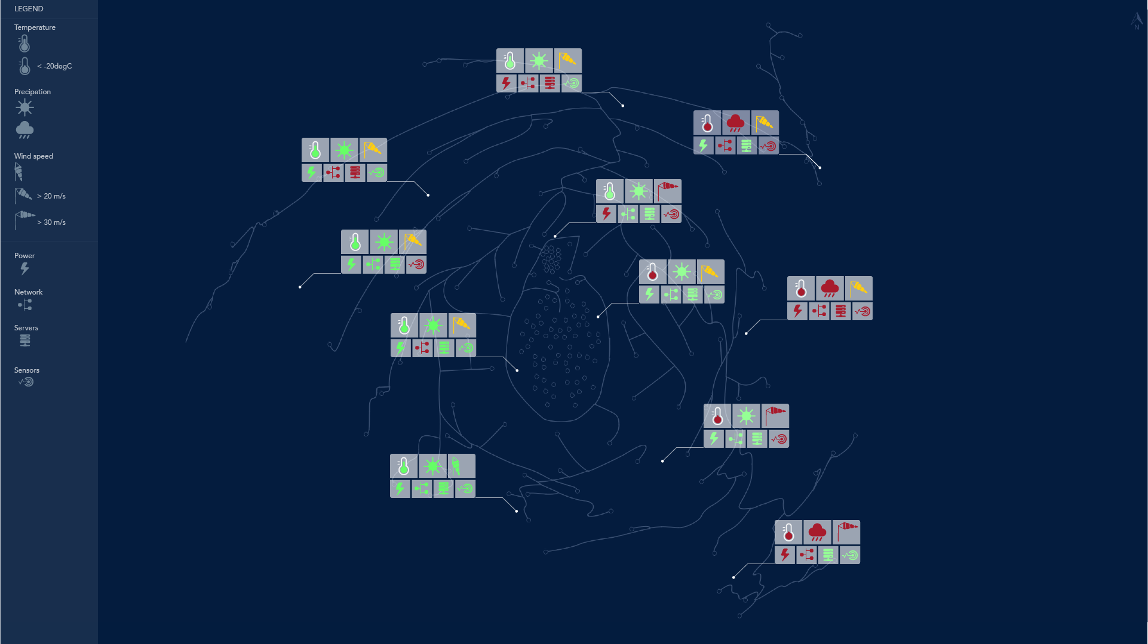
Alarm panel mock-ups
Weather reporting

Slide 24
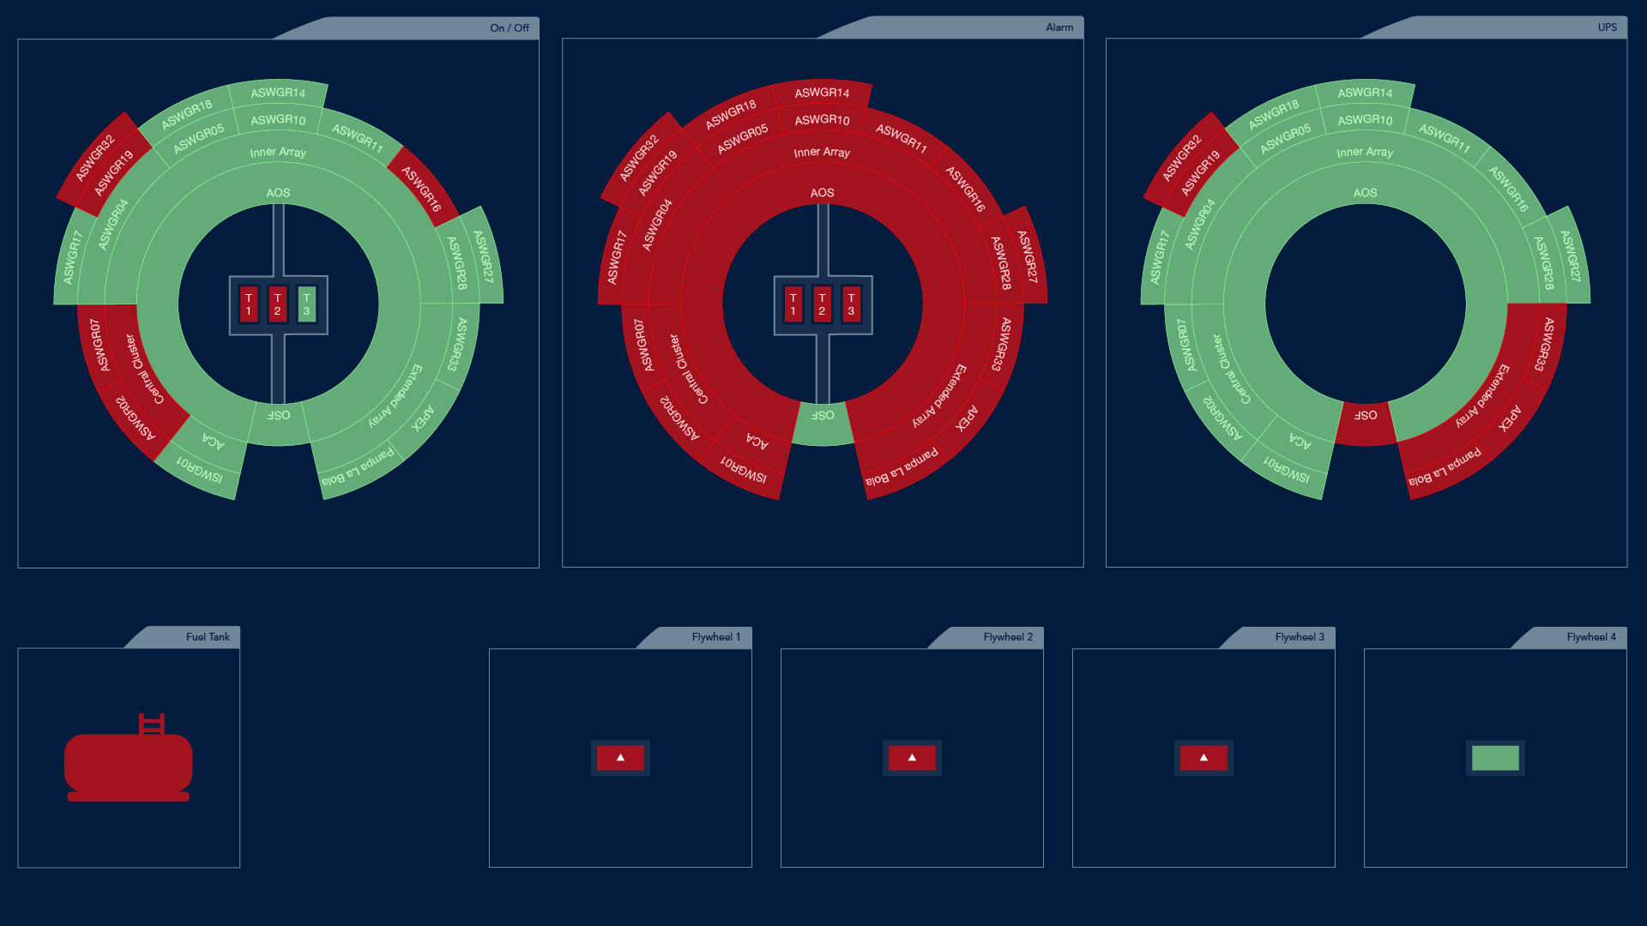
Alarm panel mock-ups
Power generation

Slide 25
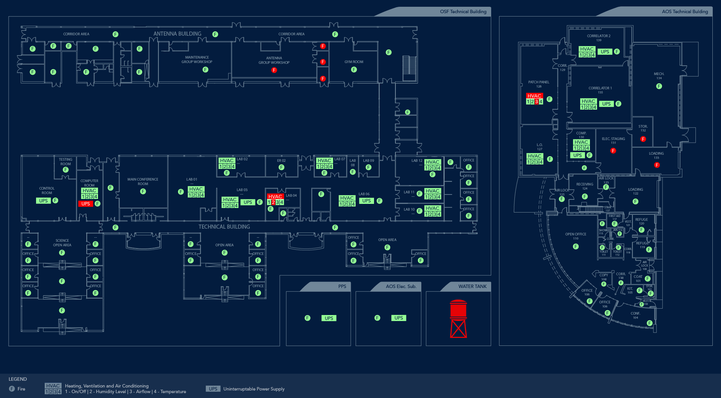
Alarm panel mock-ups
Buildings

Slide 26
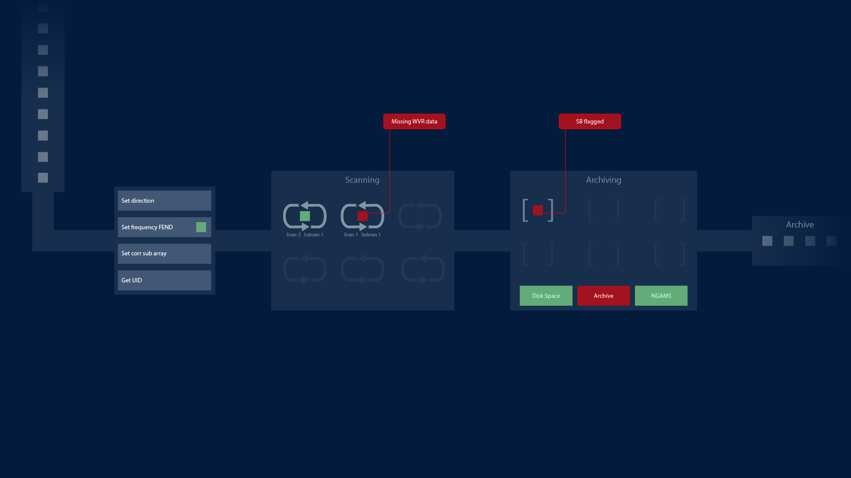
Alarm panel mock-ups
Observations

Slide 27
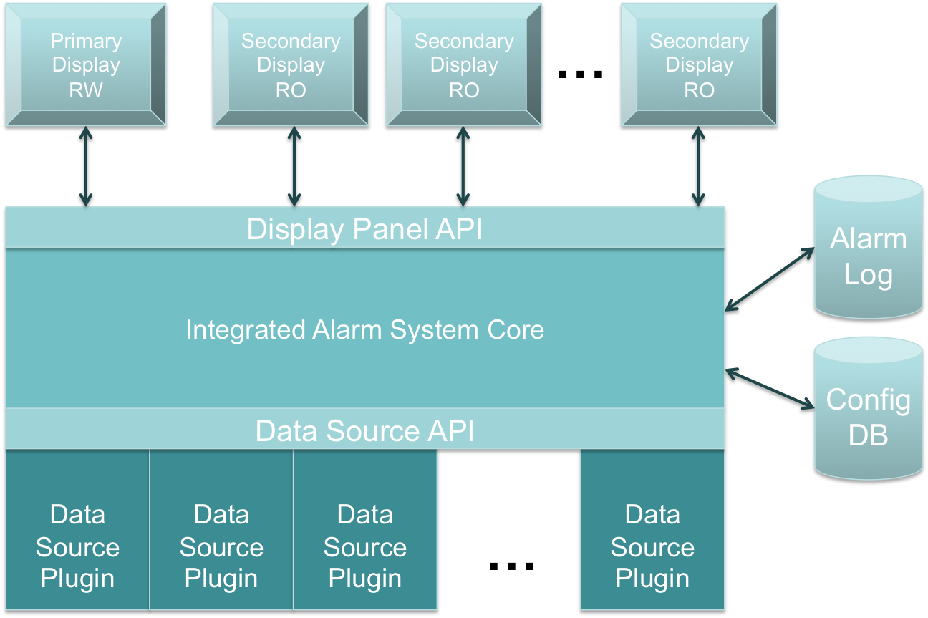
High-level Architecture

Slide 28
Next steps
Started prototyping
Start project in Jan 2017
Project duration ~ 2 years
Total effort required ~ 3.1 FTE years
1.6 ESO ISM Garching (0.8 FTE over 2 years)
1.5 ESO Contractor Santiago (1.0 FTE over 1.5 years) - TODO
Run as open-source project in Github

Slide 29
Next steps
Design to be ready by end Q1 2017
Meeting with CTA in mid December
Subsystem scientists confirmed
Emilio Barrios (Operator)& Bernhard Lopez (Engineering)
Create Project Management Plan
Light-weight design reviews
Panel members?

Slide 30
That’s all!

